Slide 1
Colonization of the marine realm and the Great Oxidation Event: Experimentally assessing the plasticity and evolution of cyanobacterial salinity tolerance
Slides as PDF or PPTX available at: https://bit.ly/39Dk1Kc
Jennifer Reeve, Boswell Wing, Christopher Greidanus, Maxwell Pashayan, Anya Sukiennicki, Paige Campbell
AbSciCon 2022 – Recent Advances, Development and New Challenges in Understanding Early Life

Slide 2
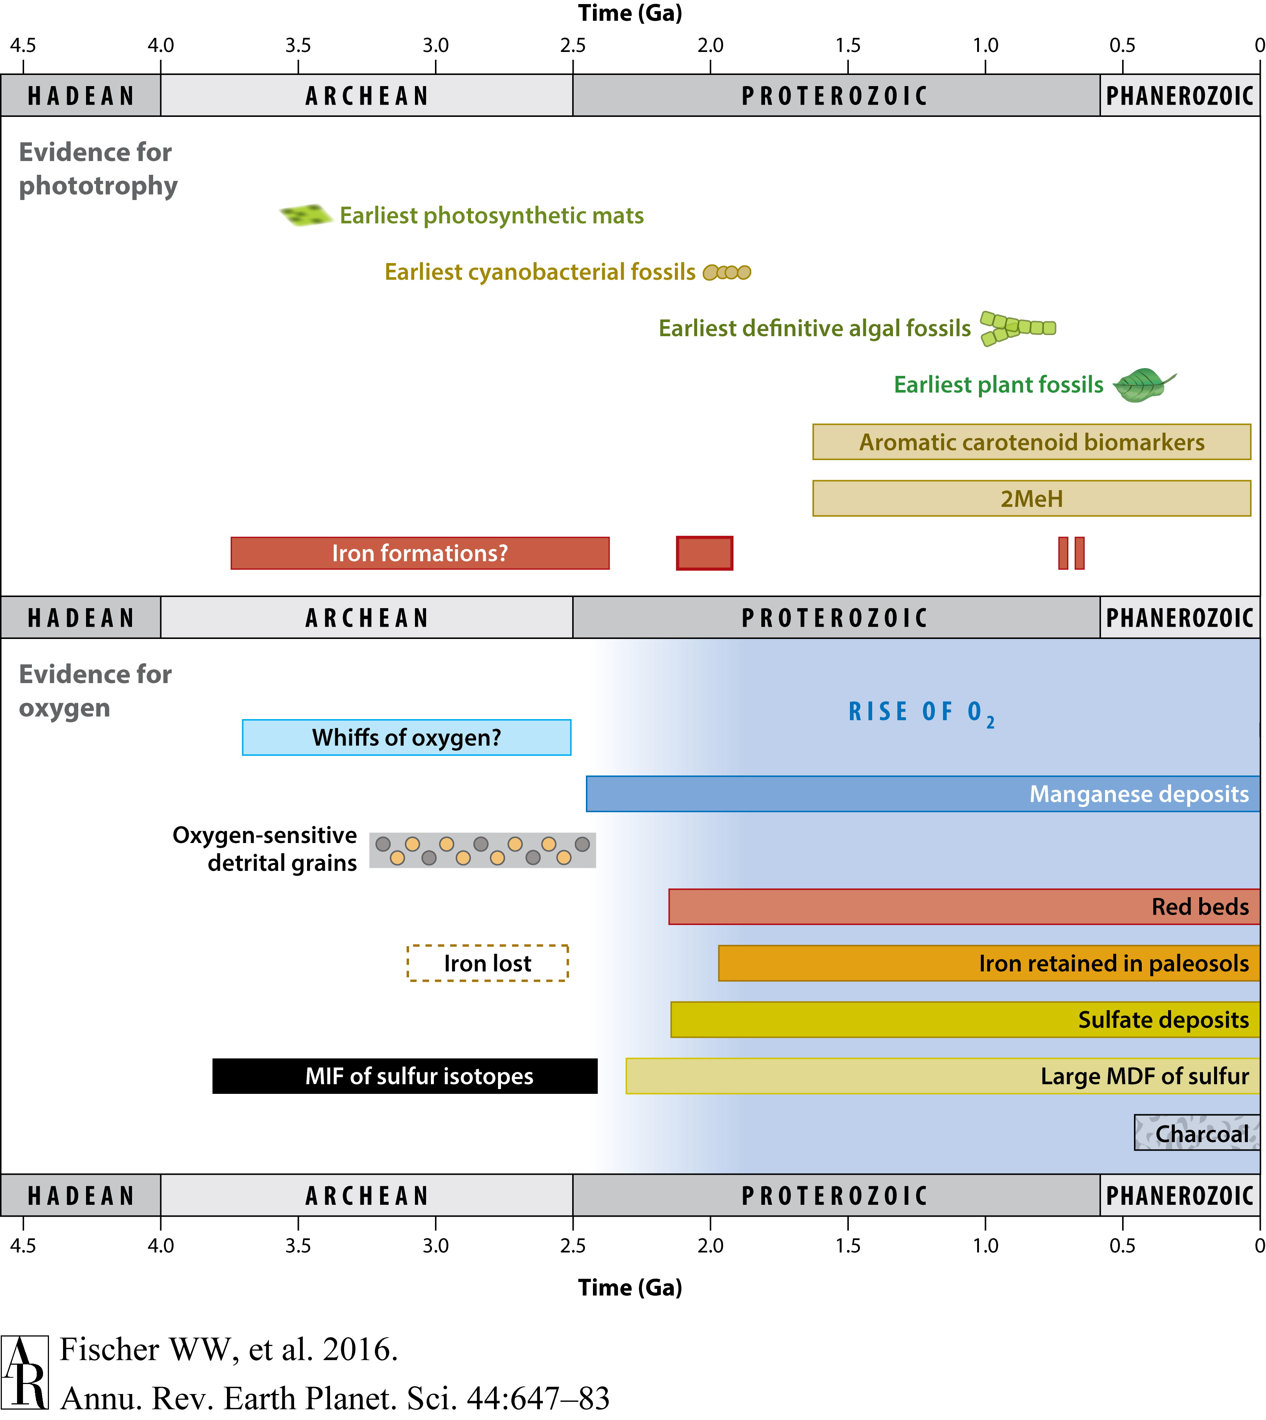
Cyanobacteria drove the oxidation of Earth's atmosphere

Slide 3
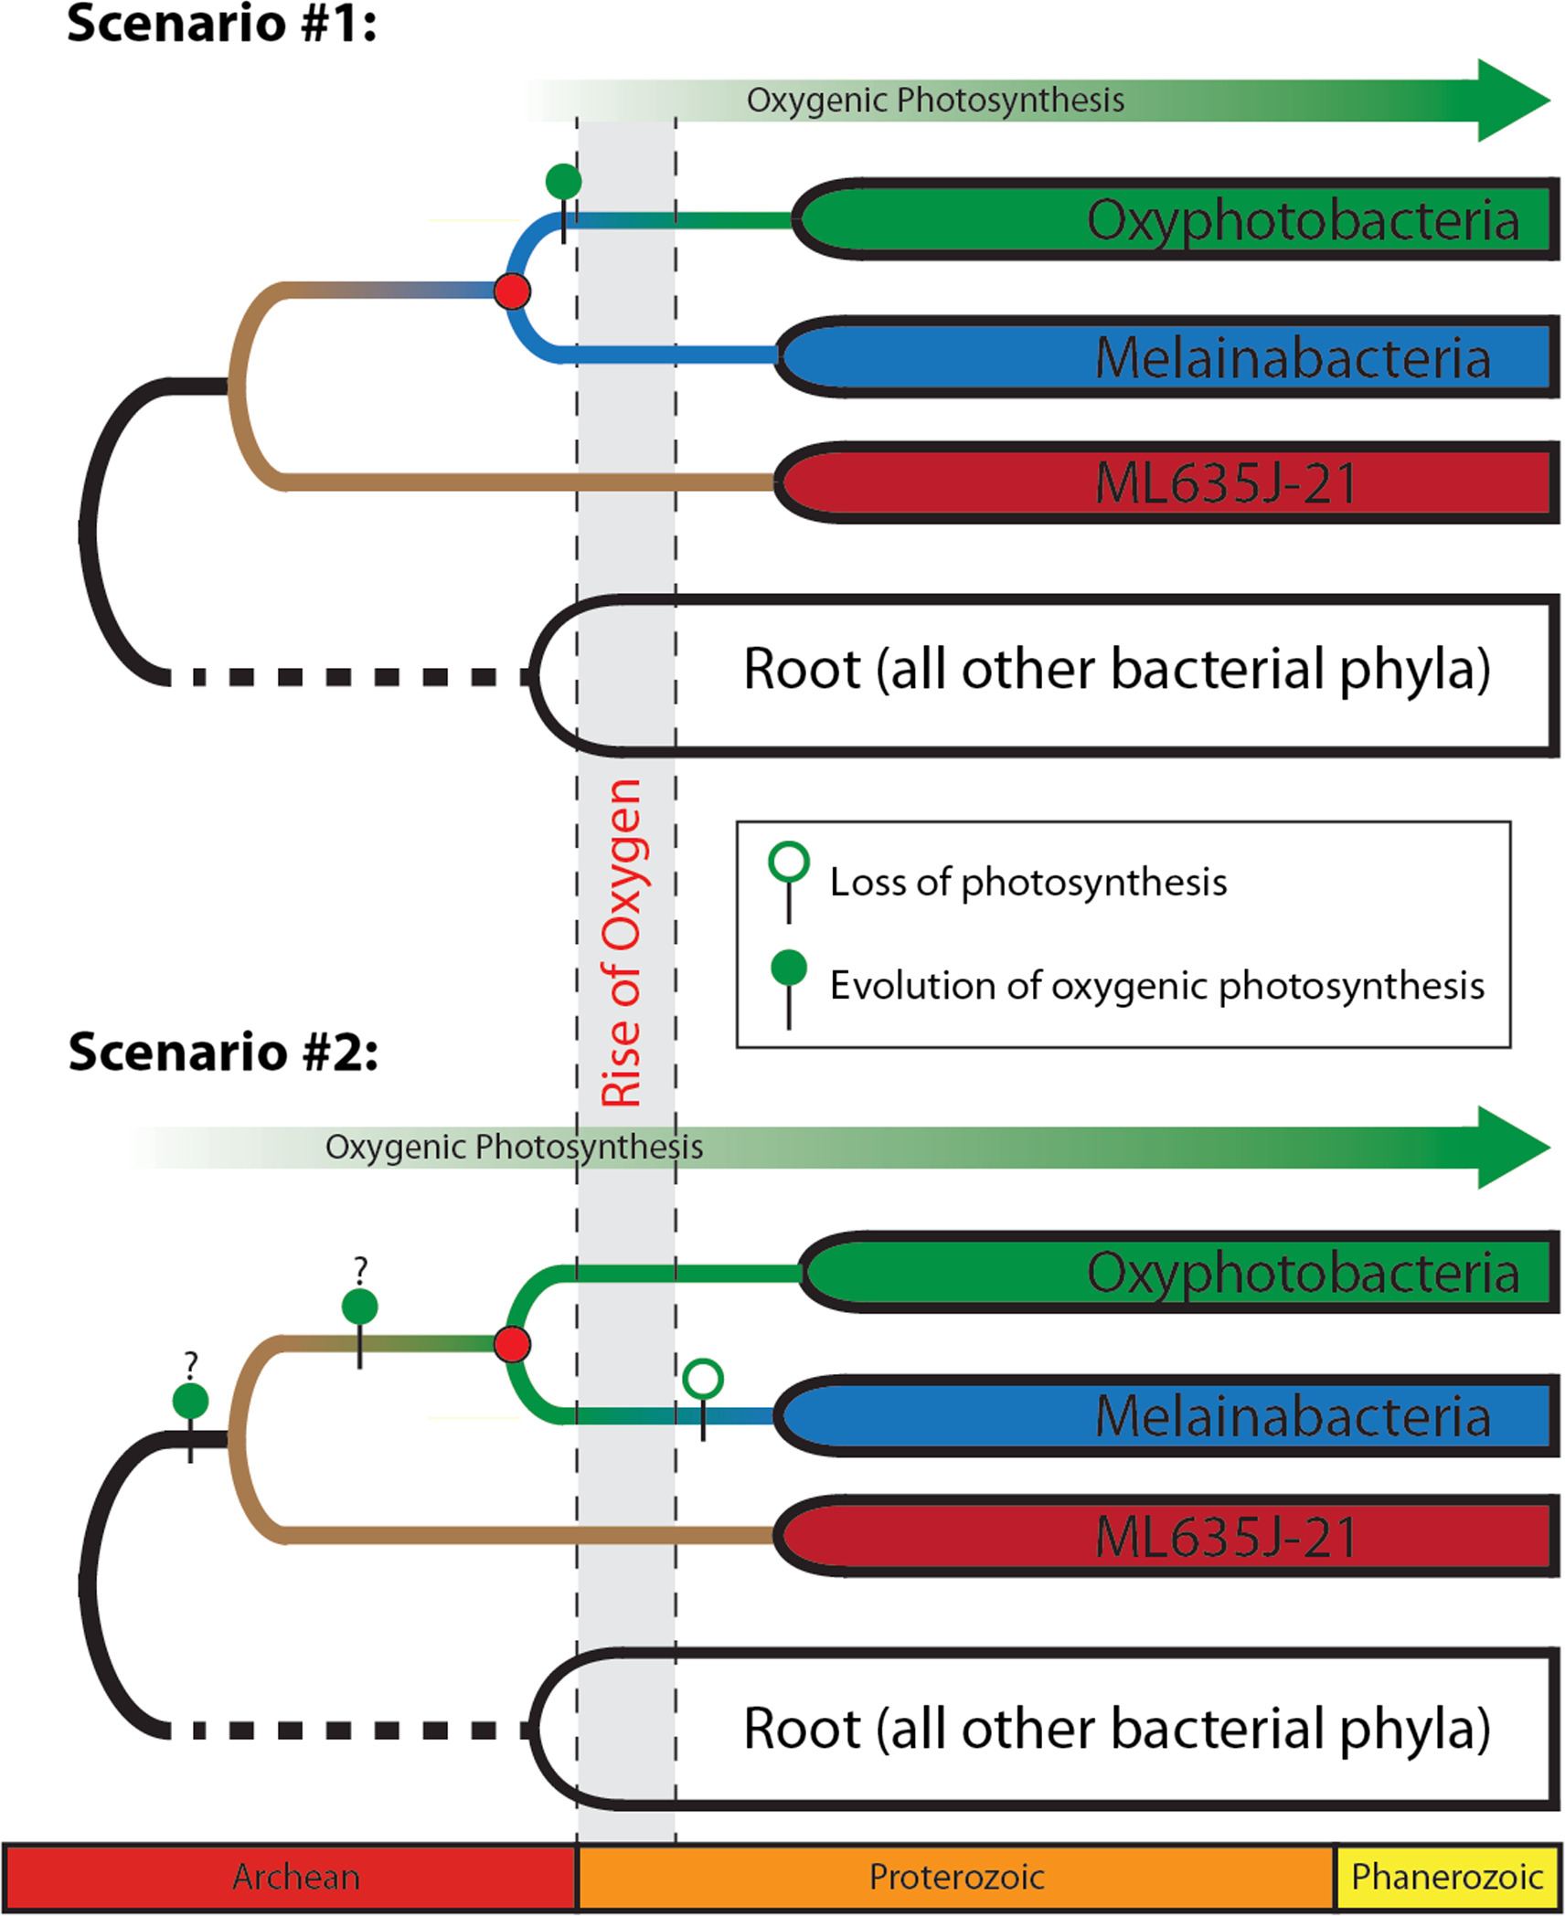
The timing of the origin of oxygenic photosynthesis is actively debated
Shih et. al. 2017

Slide 4
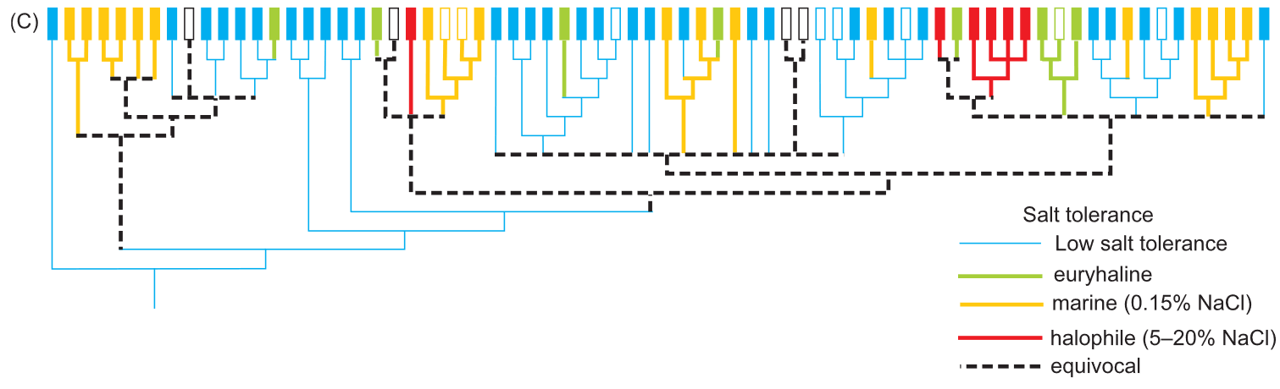
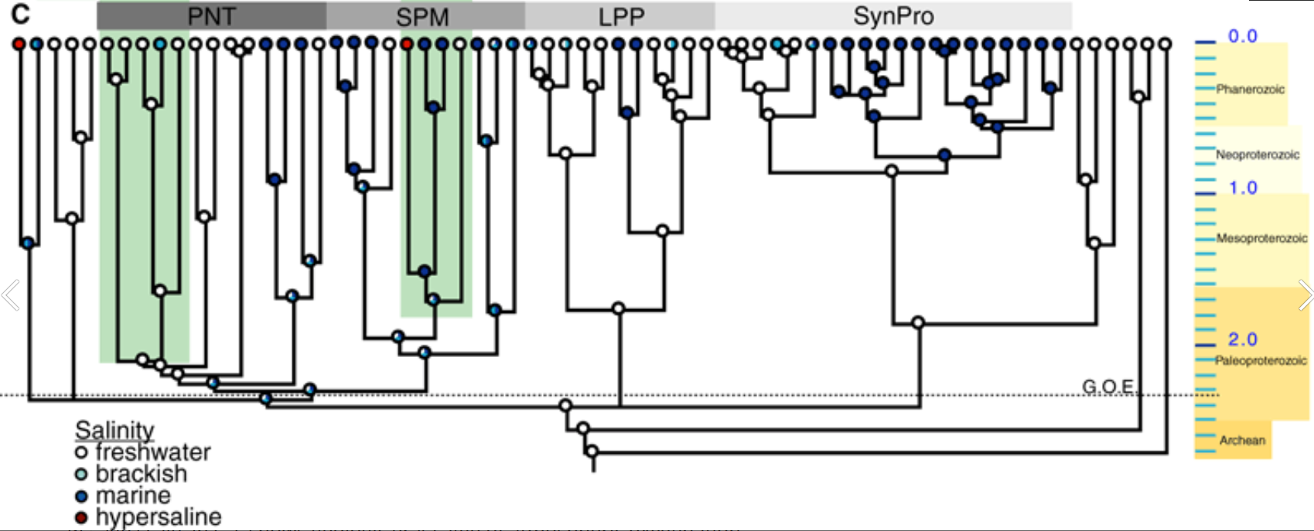
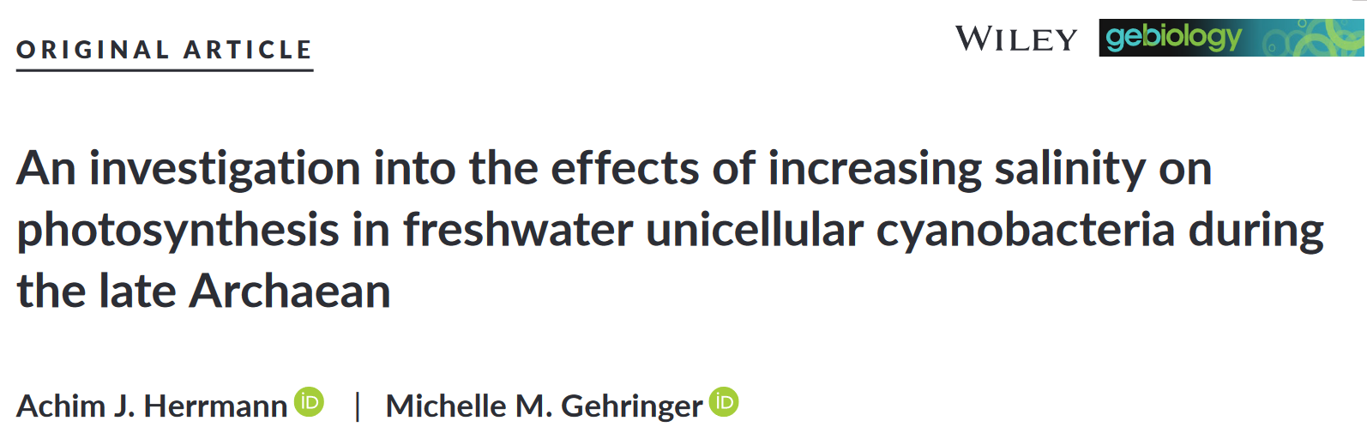
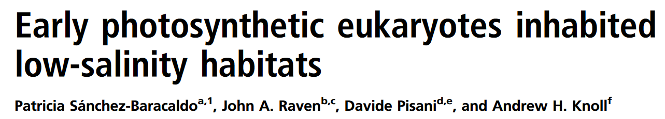
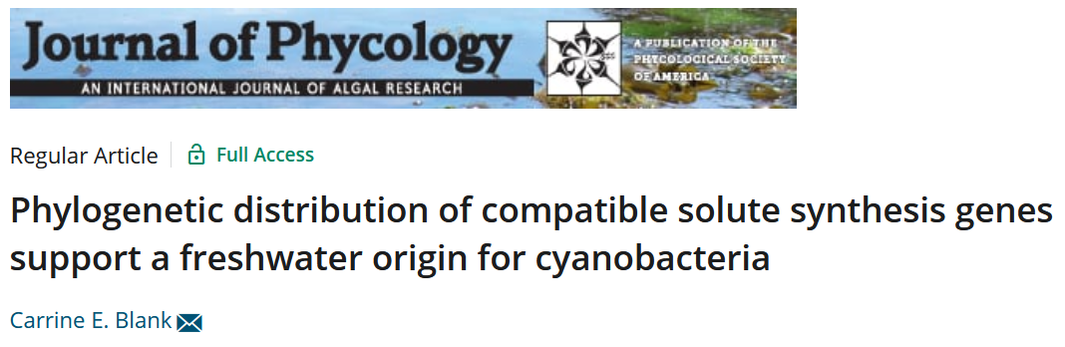
Salinity may have played a key role in the early evolution of Cyanobacteria
Sánchez-Baracaldo et. al. 2005
Blank et. al. 2009

Slide 5
Using ancestral state reconstruction (ASR) on cyanobacterial salinity tolerance relies on assumptions about extant cyanobacteria
Habitat predicts salinity tolerance
Salinity tolerance is a discrete trait

Slide 6
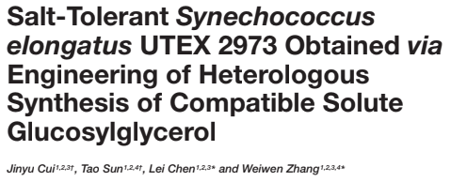
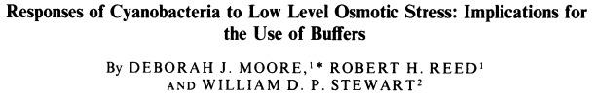
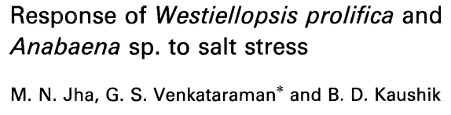
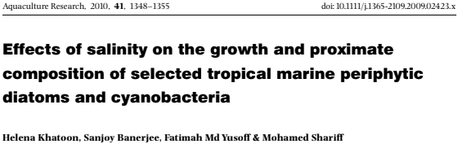
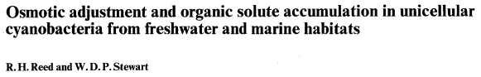
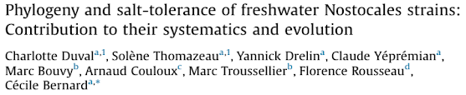
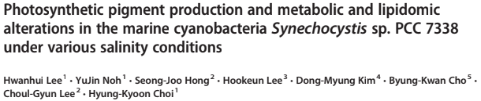
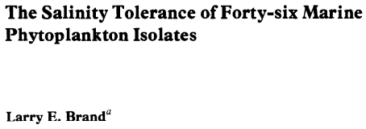
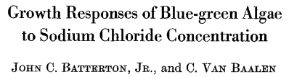
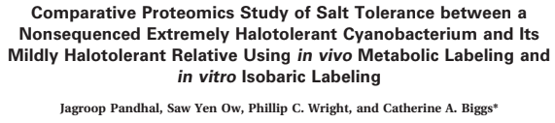
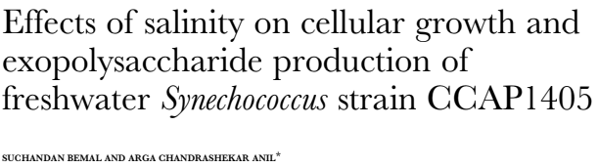
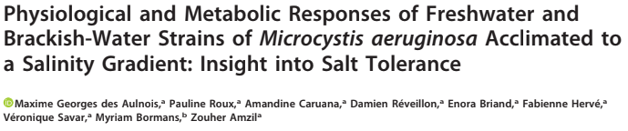
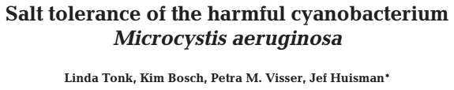
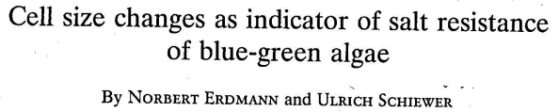
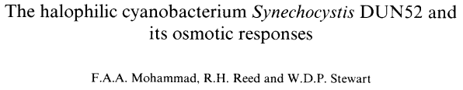
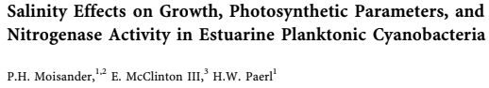
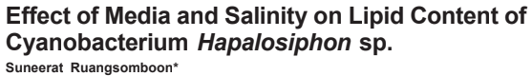
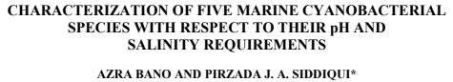
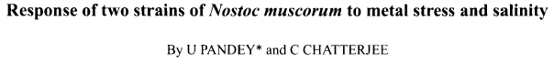
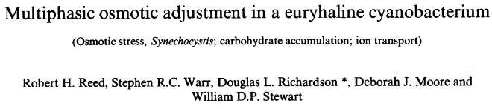
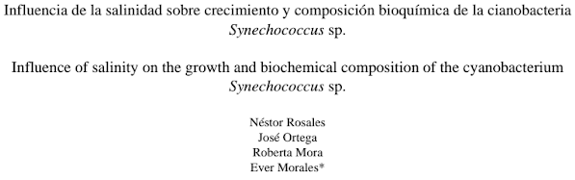
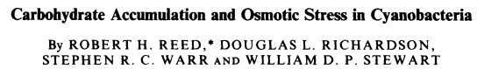
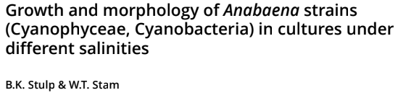
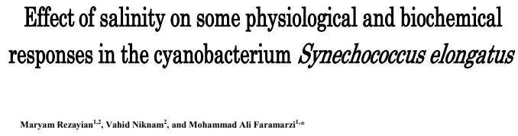
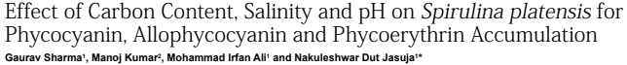
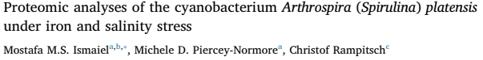
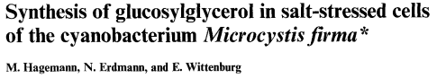
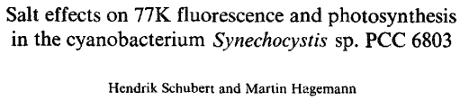
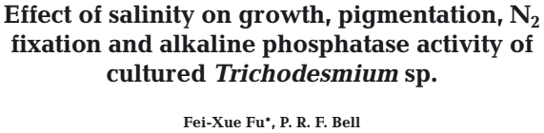
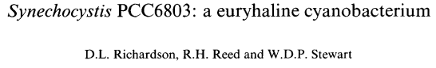
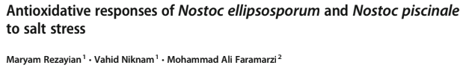
We surveyed the literature to develop a database of cyanobacterial responses to changes in salinity

Slide 7
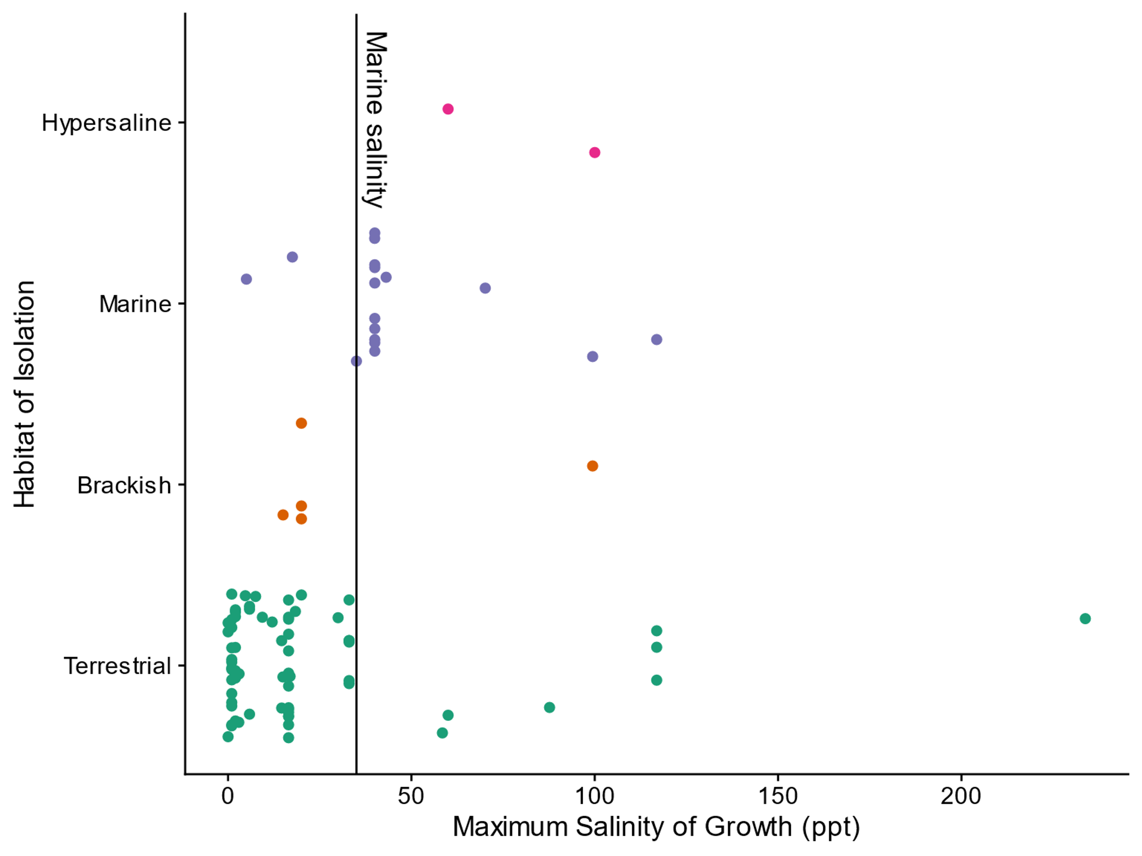
Maximum salinity of growth

Slide 8
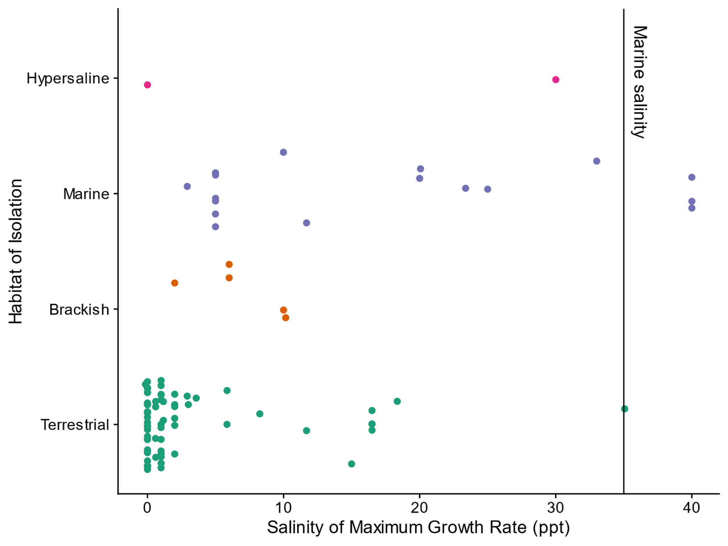
Salinity of maximum growth

Slide 9
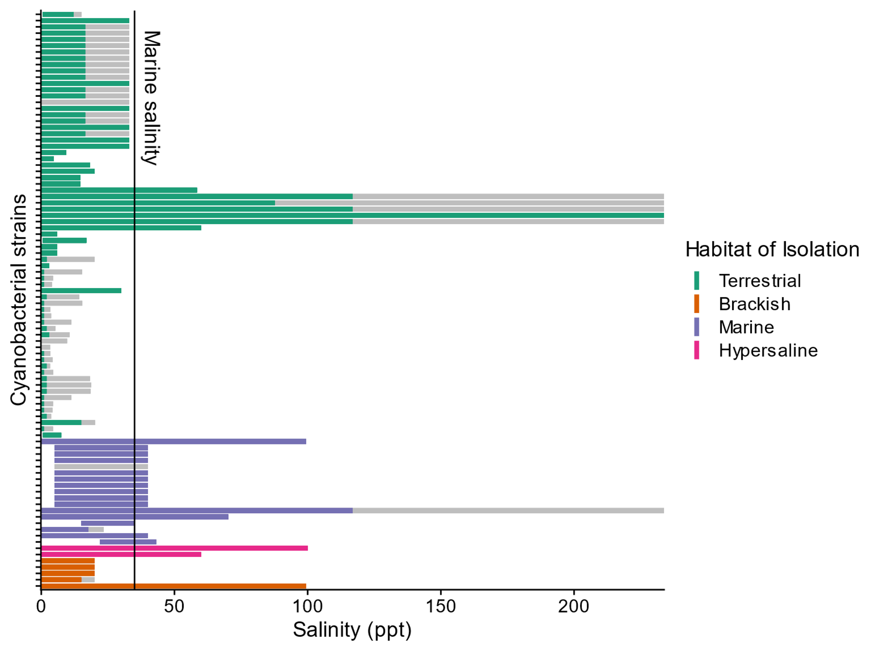
Discrete growth

Slide 10
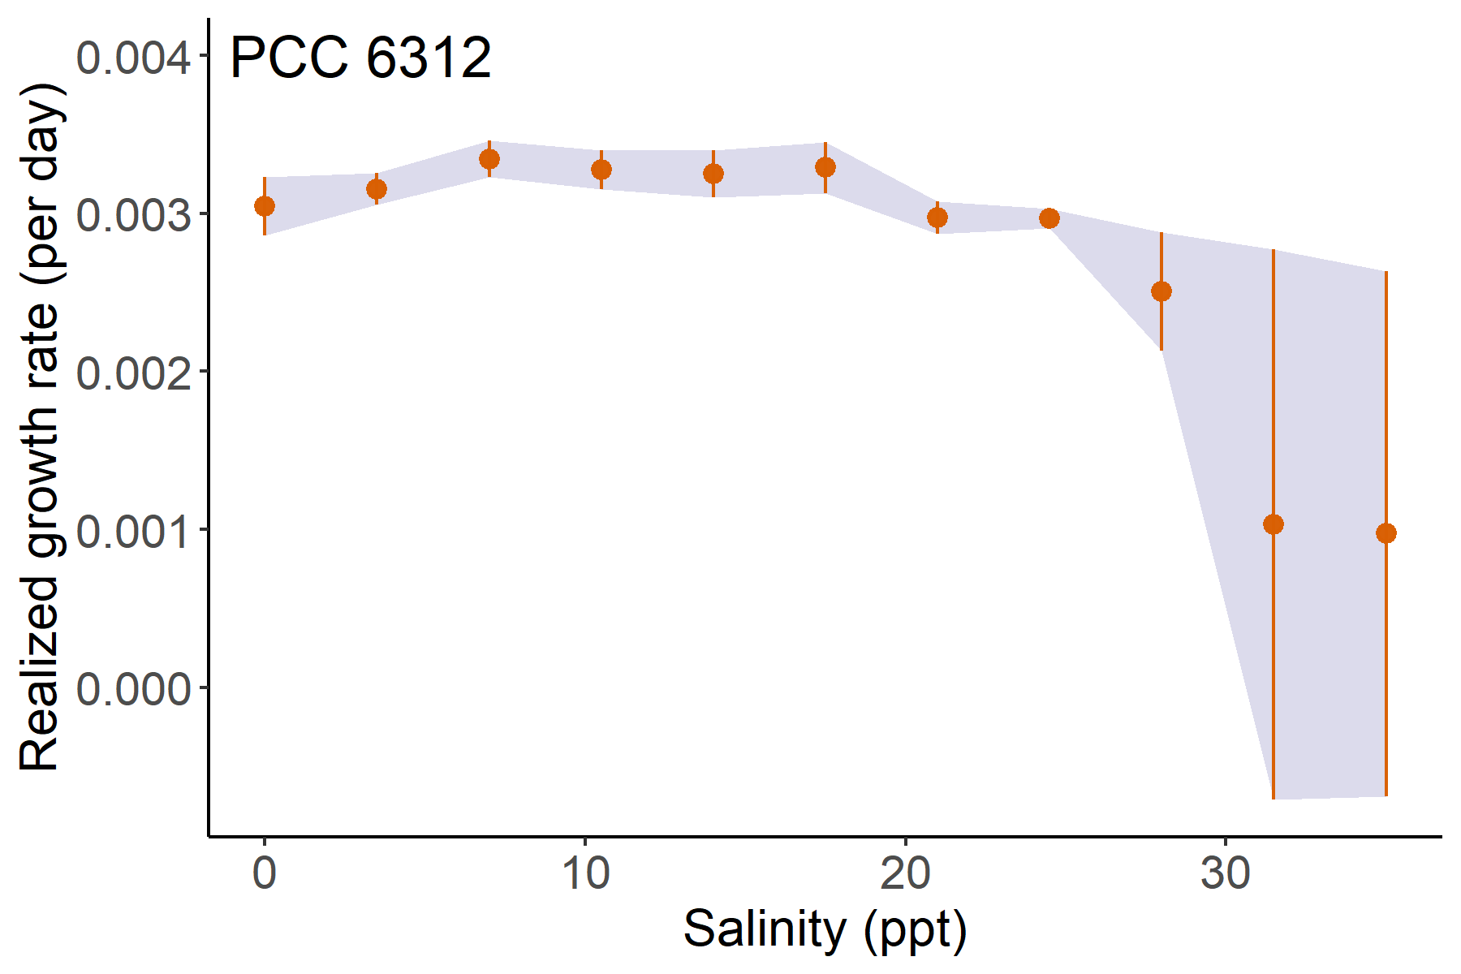
Reaction norms intro

Slide 11
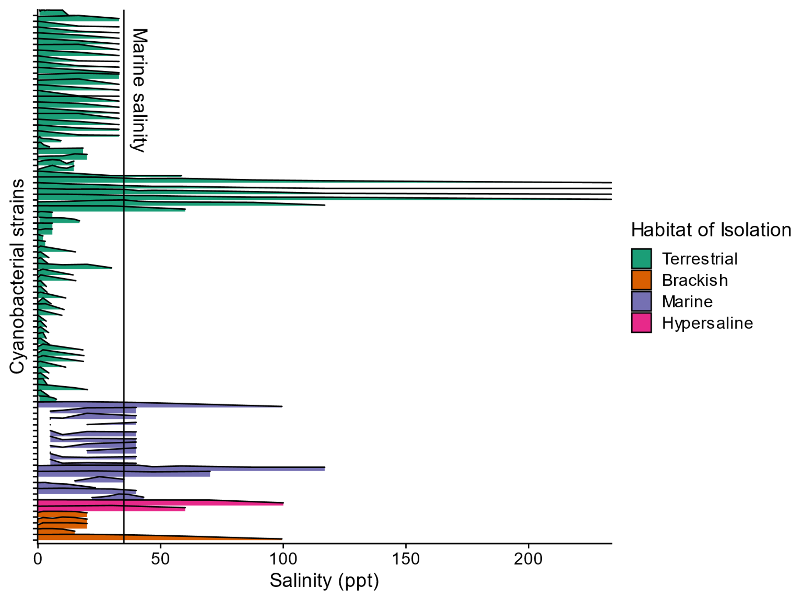
Reaction norms

Slide 12
Salinity tolerance in extant Cyanobacteria
Habitat predicts salinity tolerance
Salinity tolerance is a discrete trait

Slide 13
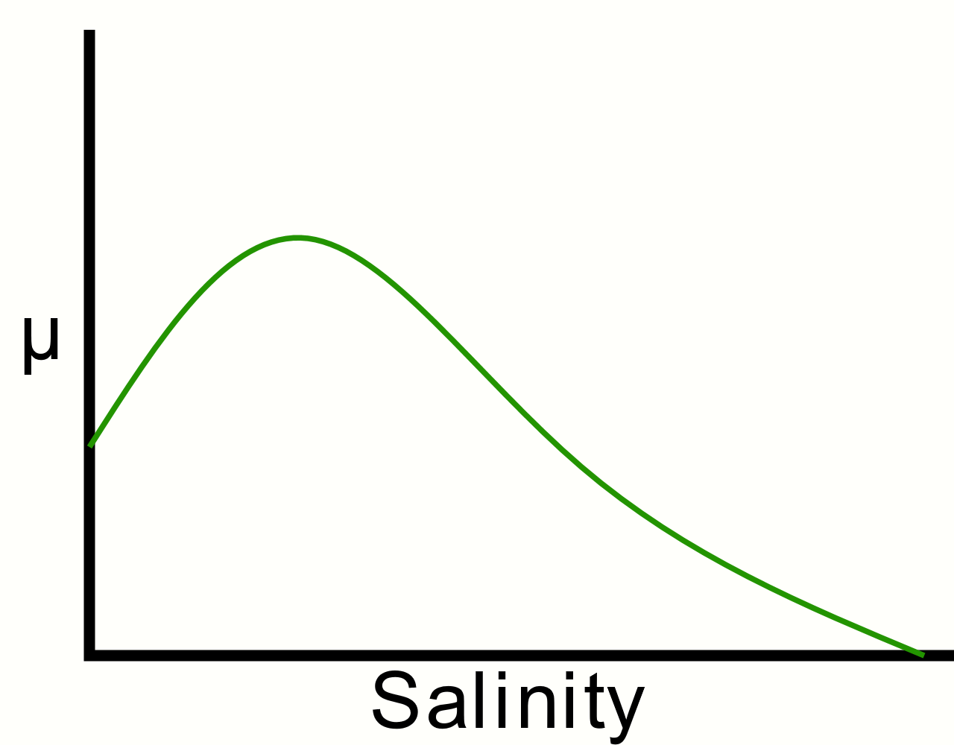
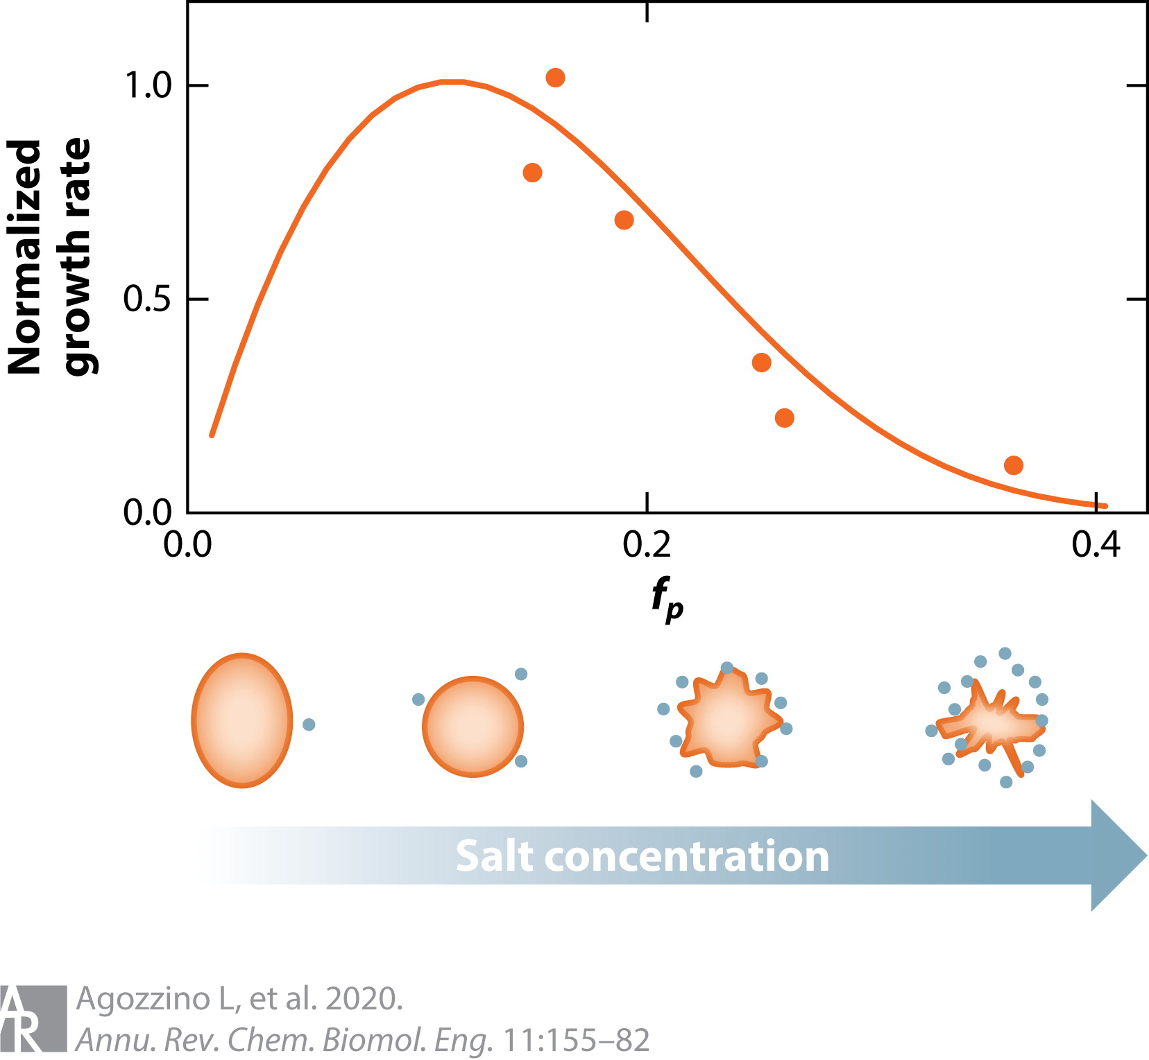
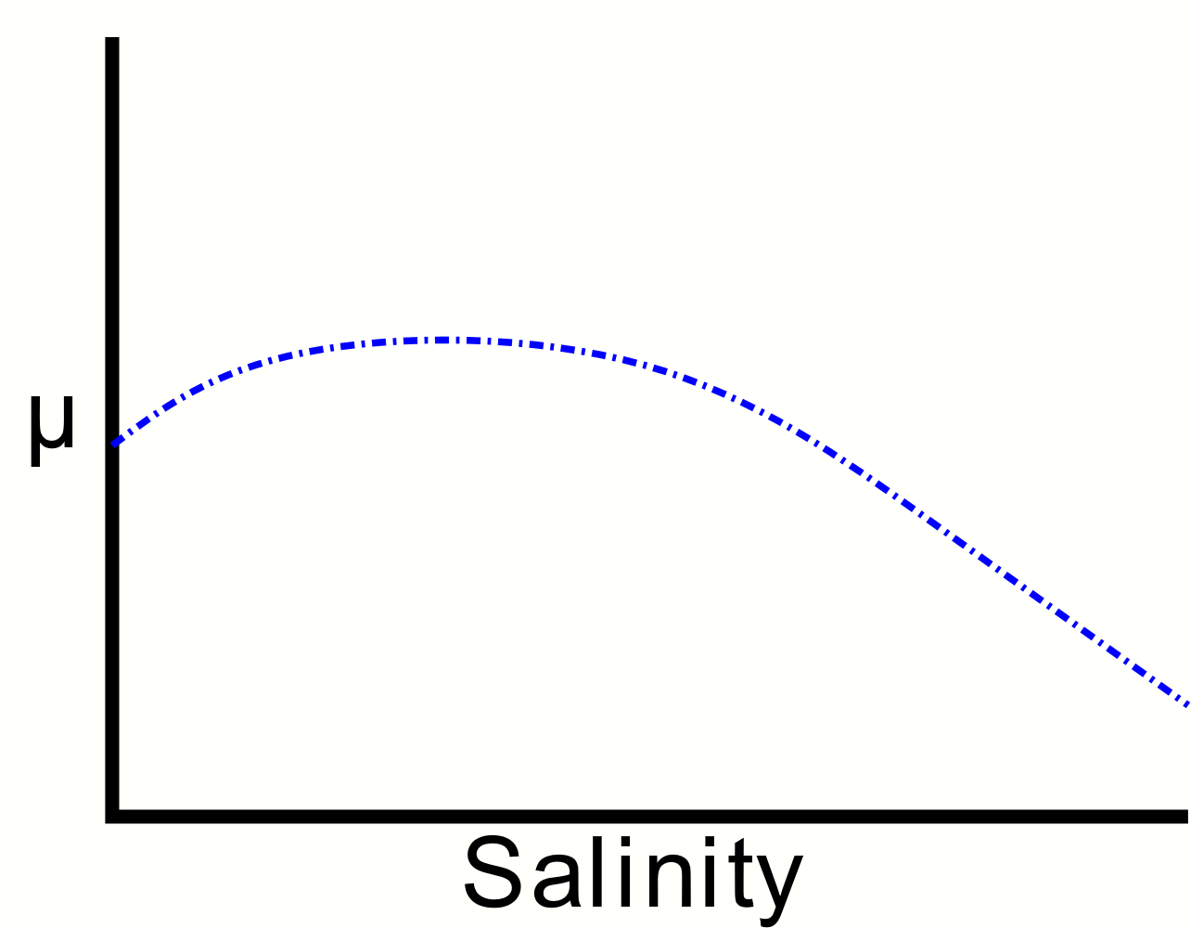
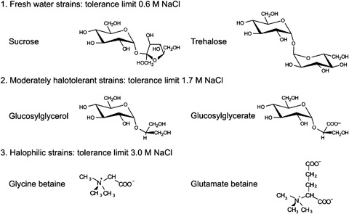
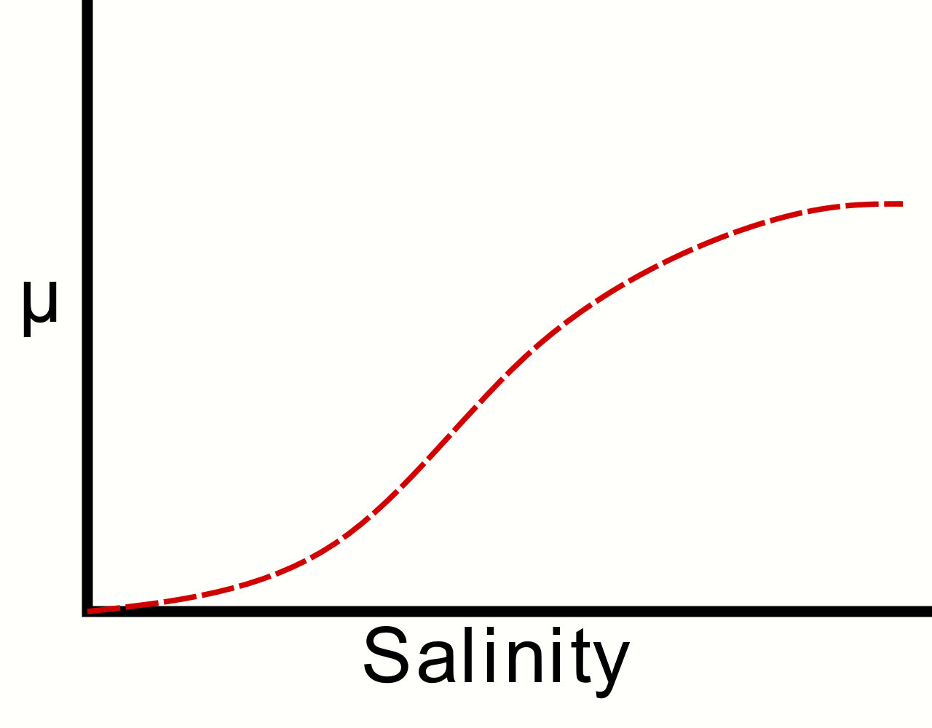
Future question: Can we identify molecular mechanisms behind the different response shapes?

Slide 14
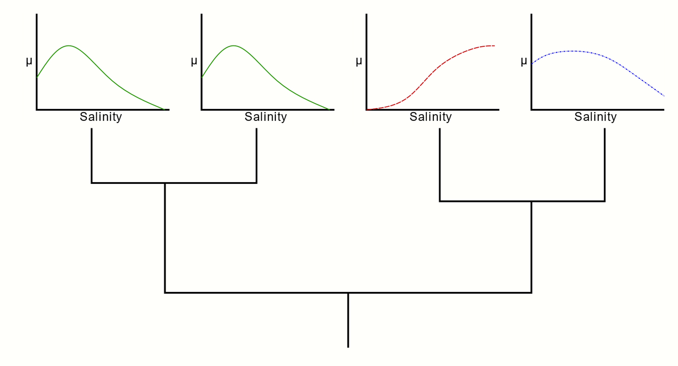
Future question: How do these reaction norms evolve?
Ancestral state reconstruction

Slide 15
Future question: How do these reaction norms evolve?
Experimental evolution

Slide 16
Acknowledgements
Support:
CU Geobiology Community, especially my graduate student colleagues/friends
Co-authors
Adam Younkin
Friends and family
Funding:
University of Colorado Boulder Graduate School

Slide 17
Questions
Email: jennifer.reeve@colorado.edu
Twitter: @seejenscience

